Slide 1
My Aggie Wellness Journey
Notes:
AS STUDENTS ARRIVE TO CLASS
As students arrive in class:
● Ask them to sit in/near their pre-assigned groups
● Peer mentor and instructor circulate throughout teams prompting discussion within the teams about the video
Did everyone have a chance to watch the video?
Yes - what did you think?
No - can someone summarize the video for the class?
Do you think any of the dimensions are more important than the others?
This usually sparks some discussion and debate. Allow for this then, steer the discussion to answer: All dimensions are important and necessary, we strive for balanced attention for all eight. Often we find overlap among several dimensions.
For example, sleep is in the physical category, but being sleep deprived affects mental, social, intellectual, and occupational wellness, too.

Slide 2
What are the Eight Dimensions of Wellness?
Notes:
Ask this question to encourage brief discussion/response.
Remember the 8 dimensions of wellness video on the My Aggie Wellness Journey website that was sent to you by ______ (peer mentor)? Based on what you learned from that video, which of the 8 dimensions of wellness can you name?
Answers: Physical, Mental, Social, Intellectual, Spiritual, Occupational, Financial, Environmental (https://www.youtube.com/watch?v=2NR4_5dt7JA)

Slide 3
Eight Dimensions of Wellness
Physical
Mental
Social
Intellectual
Spiritual
Occupational
Financial
Environmental
Notes:
Great, yes! Those are all dimensions of wellness. The video mentions that each of these dimensions impacts the others, and that all of them equally influence our overall well being. This is true for just about every stage of life, even college. College can be challenging in many ways, so today we are going to look at a case study that was created to help us see how some of these dimensions of wellness might appear in our lives. Hopefully you read the case study before class. Remember that this may not look exactly like YOUR typical day, but parts of it might sound familiar. Only social, physical, intellectual, and mental wellness are included in today’s case study.
To include all 8 dimensions in your section on another class day - view the “Supplement” tab of the My Aggie Wellness Journey Curriculum website to engage your class in another case study which includes the remaining four dimensions, occupational, spiritual, financial, and environmental.

Slide 4
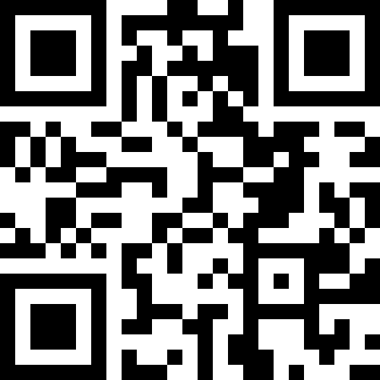
Case Study
This case study will take you through a semester with our student Andi
Read the case study with your group to identify healthy and unhealthy choices
Replace unhealthy choices with a healthier choice
Select a spokesperson from your group to share your key points of discussion with the class
Notes:
To save time, divide class into groups of 4-5 students ahead of time. Groups should discuss the case study together, identifying unhealthy behaviors and brainstorming healthier behaviors that could be replaced. Each group should select a “spokesperson” to share their group’s main discussion points with the larger class. Remember, only social, physical, intellectual, and mental wellness are included in this case study.
Together with your team, go through the case study, identify healthy and unhealthy behaviors. The case study will prompt you to select each statement and identify if it is a healthy or unhealthy behavior.
If the statement is an unhealthy behavior, your team will discuss reasonable, realistic, healthier choices that you think Andi could make. Keep in mind, there are no perfect solutions. Try to put yourself in her shoes and think about realistic changes you and your team would be willing to make. Be sure to choose one member of your group who will share key points of your discussion with the rest of the class. You’ll have 10 minutes to complete this activity!

Slide 5
Team Discussion
Did you notice one dimension of wellness affecting another dimension?
Would you make the changes you and your team identified?
What would you do differently?
**Remember: Health is an individual choice and what works for one person may not work for someone else
Notes:
Okay, time is up! Let’s hear from each group what you noticed and how you would substitute healthier behaviors.
Peer Mentor: facilitate discussion among class. Ask students to name the different dimensions of wellness associated with the examples they share. Other Potential questions for the class are below and on the PowerPoint:
1) Did you notice one dimension of wellness affecting another dimension? 2) Would you make the changes you and your team identified? 3) What would you do differently?
These were great examples! Remember, a wellness journey is an individual choice and what works for one person may not work for someone else. Let’s take a look at our own wellness journey. We are going to reflect on your wellness journey - what does your wellness look like?

Slide 6
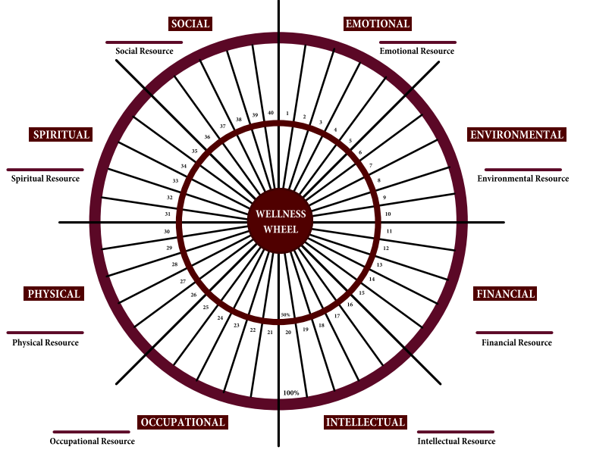
Wellness Wheel
Read each statement and fill in the corresponding section of the wheel to the degree you feel is accurate for you
Example: Question #1 is "I can feel and understand my emotions."
If you do this 100% of the time, fill in all of section 1
If you do this 35% of the time, fill in 35% of the section 1
After completing each statement, identify a campus resource to enhance each dimension.
Remember, this is about harmony and finding areas that we can improve on!
Notes:
Open the Wellness Wheel Activity under the “Activities” tab of the My Aggie Wellness Journey Curriculum website. Explain the directions for the wellness wheel activity - preview the example to students. While explaining the resources portion of the activity, show students an example of the listed resources for your campus under the “Emotional” page of the website.
You all will take the rest of class to reflect on your personal well-being by completing your own wellness wheel. You will take the wellness wheel and read each statement and fill in the corresponding section of the wheel to the degree you feel is accurate for you. The big circle represents 100% while the smaller circle represents 50%.
For example, Question #1 is "I can feel and understand my emotions." If you do this 100% of the time, fill in all of section 1. If you do this 25 or 30% of the time, then fill in part of the 50% circle. You will fill in each part of the circle then analyze which dimension is your strongest and which dimension you could develop.
Once you have identified the dimension you could develop - you will begin to identify resources that could support you in each dimension. Starting with the dimension you could develop the most, use the My Aggie Wellness Journey Curriculum website to identify resources under each dimension.
Students may not finish pairing all 8 dimensions with a resource which is okay. Encourage students to continue their self-reflection

Slide 7
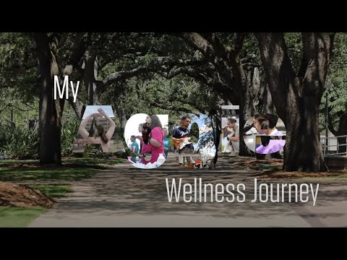
My Aggie Wellness Journey Takeaways
All dimensions are equally important
Add value to your life
Impact your overall health and well-being
We strive for balance - not perfection
There are many options for replacing unhealthy choices
What works for one person may not always work for you
Some days will go well, others will not
We all experience this, not just Freshmen
Goal: Learn to develop a healthy routine, good time management skills, and seek help/resources
Notes:
As a class, discuss the following takeaways (call and answer).
Below are the takeaways from this lesson-
● All dimensions are equally important, add value to your life, impact your overall health and well-being.
● We are not perfect, we strive for balance - not perfection.
● There are many options for replacing poor choices, noted by different choices from each group, and choices you may have also thought of reading the example.
● Some days are going to go well, others are not. That’s a common experience for all of us, not just Freshmen.
● The goal is to learn to develop a healthy routine, good time management skills, and seek help/resources.
With this lesson, we have included a list of campus/community resources for TAMU-College Station, TAMU-Galveston, TAMU-McAllen, and TAMU Qatar that can be found on the My Aggie Wellness Journey Curriculum website which can be posted as a link on Canvas or copied for students.

Slide 8
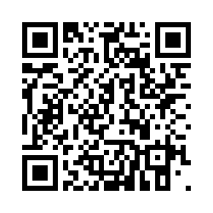
My Aggie Wellness Journey Survey
tx.ag/HUWellnessSurvey
Please provide feedback regarding your participation in the My Aggie Wellness Journey curriculum. Your responses will help Health Promotion improve future programming and curriculum.

